Slide 1
Cross Sections of CdTe Solar cells

Slide 2
Overview on what is in the folder
Each sample has it’s folder:
CdTe_X_NBL31
CdTe_X_NBL33
CdTe_X_TS58A
Python 2.7 scripts, with which the raw data has been processed and written to csv, png, and svg
align.spec which is a file containing the metadata form the beamtime (a log of all scans)
An input file for the python scripts
A readMe.txt for an explanation in text version

Slide 3
Where is the data to start working?
Each sample has two sub folders
RawData
ProcessedData
To get started you only need the ProcessedData folder
It contains all Data of the sample in csv data format (Fluorescence, XBIC and one Metadata file for each scan)
The unit for XBIC is Ampere and for Fluorescence it is cts/s
The Data is stored in a Matrix, which corresponds to the pixels in the images
SVG and PNG images are also there for all maps

Slide 4
Overview of the Samples and Scans
CdTe_X_TS58A: 2, 3, 4, 5
CdTe_X_NBL31: 1, 6, 7, 8
CdTe_X_NBL33: 1, 2, 12, 13, 14, 15, 17, 20
The following slides are overviews for each sample

Slide 5
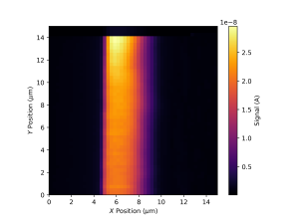
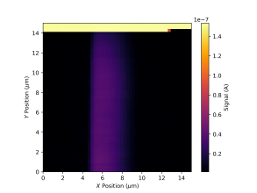
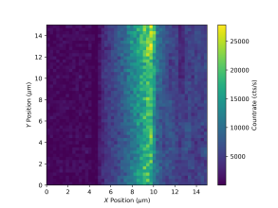
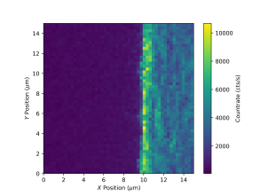
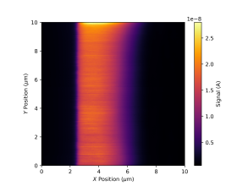
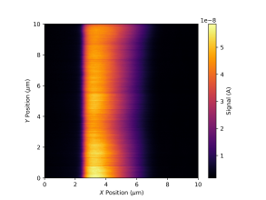
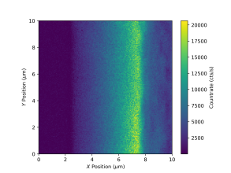
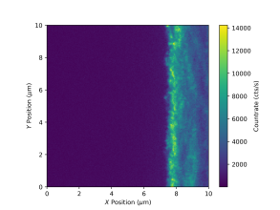
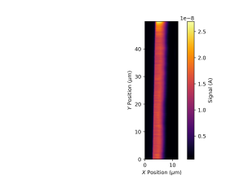
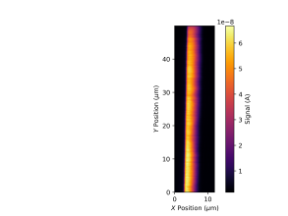
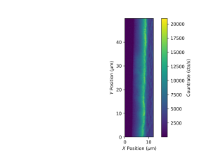
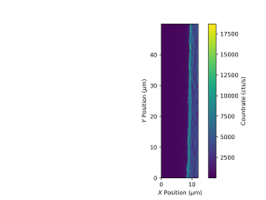
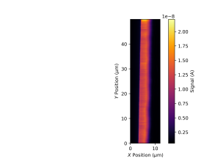
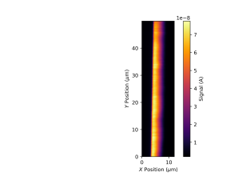
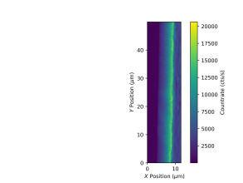
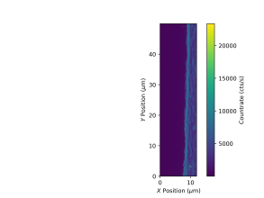
CdTe_X_TS58A
Scan Lock-in(XBIC) Direct (XBIC) Te (XRF, L2) Cu (XRF)
2
3
4
5

Slide 6
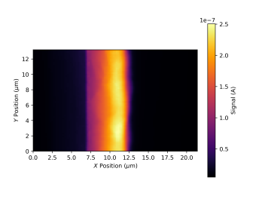

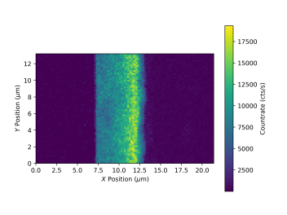
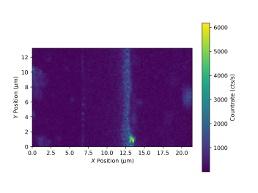
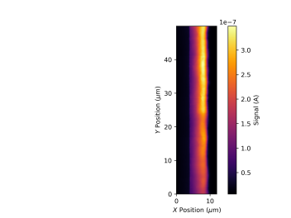
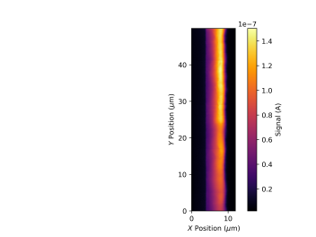
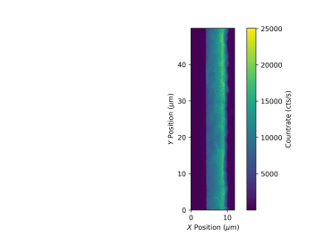
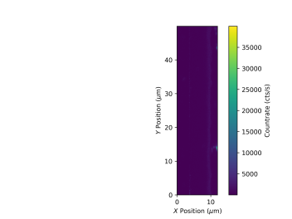
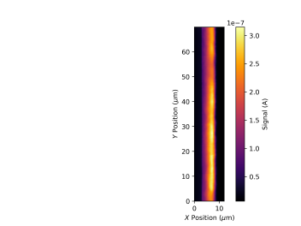

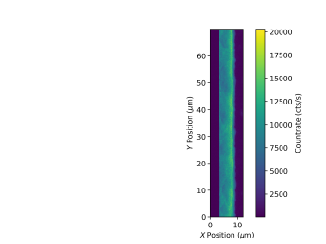
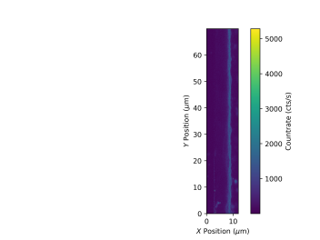
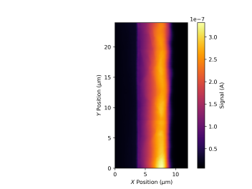

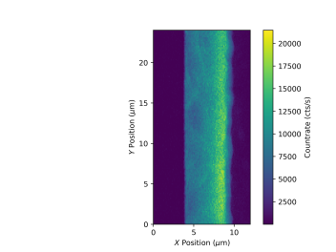
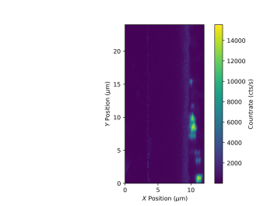
CdTe_X_NBL31
Scan Lock-in(XBIC) Direct (XBIC) Te (XRF, L2) Cu (XRF)
1
6
7
8

Slide 7
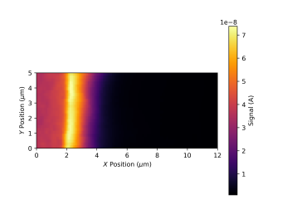

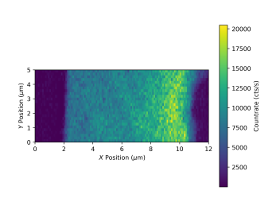
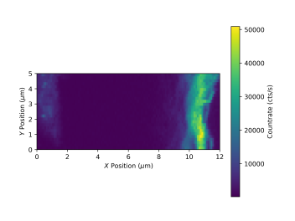
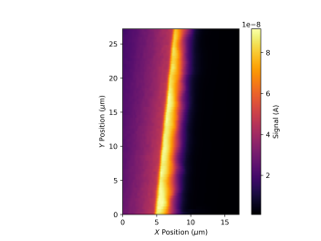
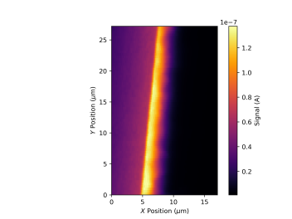
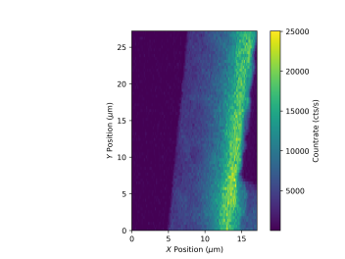
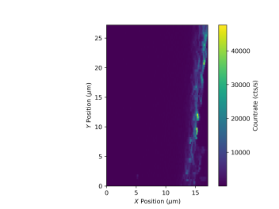
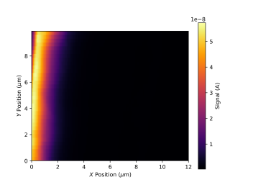
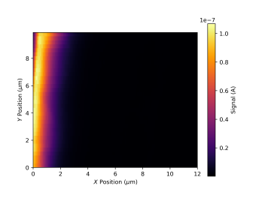
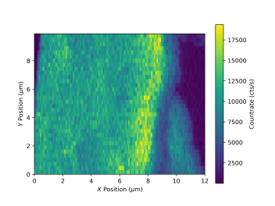
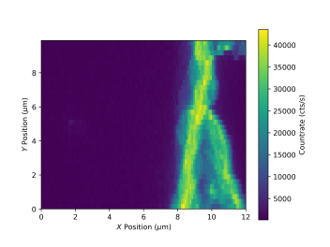
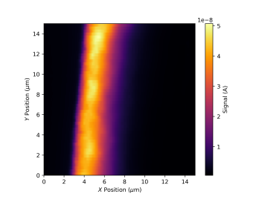
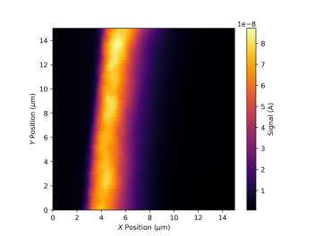
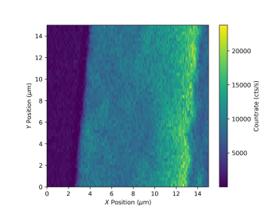
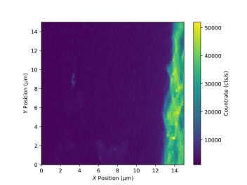
CdTe_X_NBL33 – Part 1
Scan Lock-in(XBIC) Direct (XBIC) Te (XRF, L2) Cu (XRF)
1
2
12
13

Slide 8
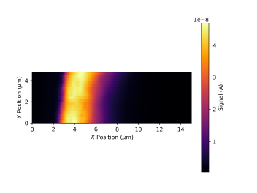

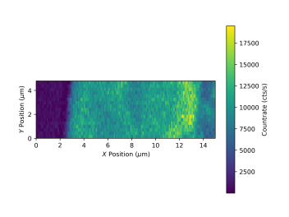
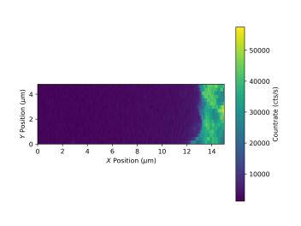
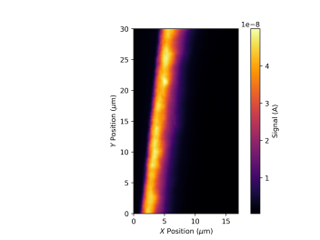

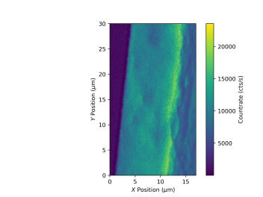
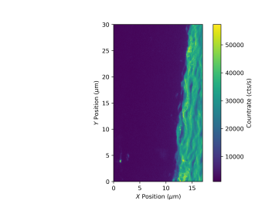








CdTe_X_NBL33 – Part 2
Scan Lock-in(XBIC) Direct (XBIC) Te (XRF, L2) Cu (XRF)
14
15
17
20

Slide 9
If you want to process the data yourself (I):
Then you need to go to the RawData folders
In there you will find the config file used in PyMCA to fit the fluorescence data
The raw XBIC data is stored in the XBIC folder for all scans of the sample.
There are several sub folders for the different scans of the sample (only fluorescence data)
Each Scan folder holds the rawFiles used for the fit process and one folder where the images resulting from my fit are stored
Use the RawFiles_for_Batchfitting if you want to redo the fit process in PyMca

Slide 10

If you want to process the data yourself (II):
I made the csv data and images with the python scripts in the top folder
You need to use python2.7 for the scripts to run, make sure that the align.spec file and the __init__.py file are in the same folder as your scripts
If you only want to re-plot one scan use the script PackageDeal_XBIC_Fluo_Meta.py
python2.7 PackageDeal_XBIC_Fluo_Meta.py ‘SampleName’ RunNumber
If you want to re-run more than one scan use the WholeDeal.py
WholeDeal.py works by calling an input File, (Here an example is given in Wrapping_input.txt) which lists all SampleName and RunNumber you want to run. Make sure that you do not have any empty lines in the file
Then it uses this input file to loop over the python function written in the PackageDeal_XBIC_Fluo_Meta_function.py script
Which is essentially the same as the PackageDeal_XBIC_Fluo_Meta.py
If you want to change the folder where stuff is saved or where data is to be found you need to change that in the PackageDeal_XBIC_Fluo_Meta.py or PackageDeal_XBIC_Fluo_Meta_function.py scripts, as this is hardcoded
Have fun!

